Slide 1
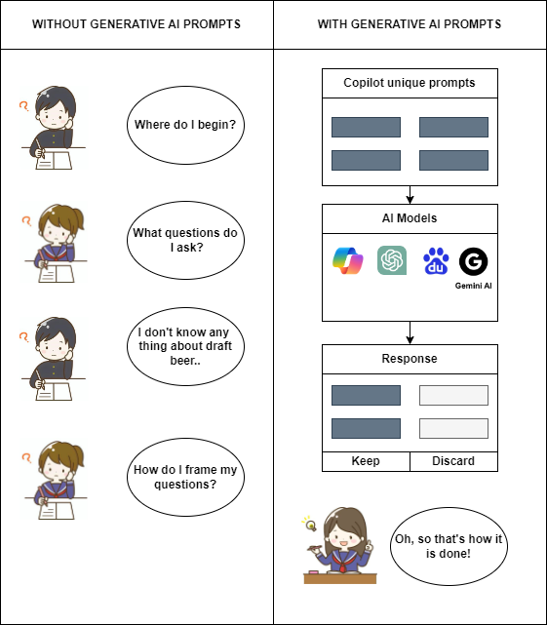
Designing a Framework - Copilot-Based Prompt Dialogs
These prompts will be unique to different functional areas, output tables & dashboards.
You can access to the Microsoft Copilot here

Slide 2
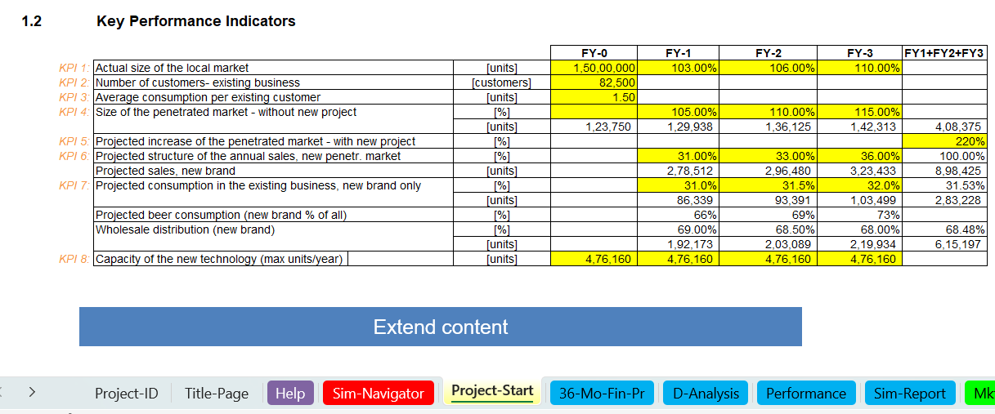
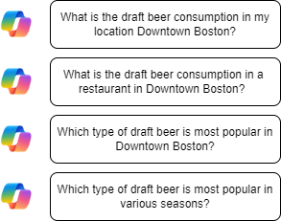
How & Where we are using the Prompts
AD715: Assignment 3 - Simulation Project
Please refer to the word document for on how these prompts generate required results here.

Slide 3
Limitations:-
Limited to only Bing Copilot - Free version.
Categories of prompts are limited to the simulation.
Lack of Offline Functionality.

